Slide 1

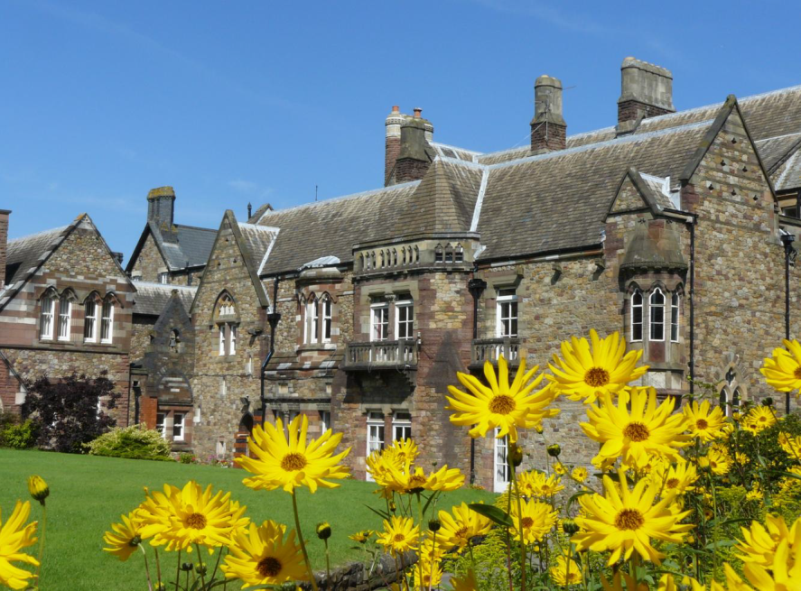
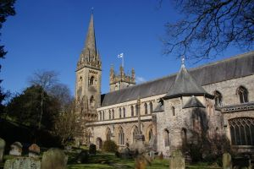
FAITH & POLICY
Pilgrimage to ‘The Land of Song’ - South Wales - 10 -13th July 2017.
Visits to popular and selected sites in the Cardiff area such as : sites in Cardiff itself - Neath – Caerphilly – Merthyr Tydfil – itinerary to be finalised nearer the time
Revd. Canon Chris Humphries is our Chaplain
Most rooms are en-suite with tea making facilities
49 seat Coach booked – Walkers Coaches as last time
Coach will take and bring us back from all venues - accommodation, breakfasts and evening meals & entrance fees will be included.
Pick-ups likely to be at St Thomas , Ellesmere Port and Poplar 2000 at Lymm M6 junction 20.
Deposit of £50 needed to secure a place. Costs expected to be similar to last Pilgrimage + inflation

